Slide 1
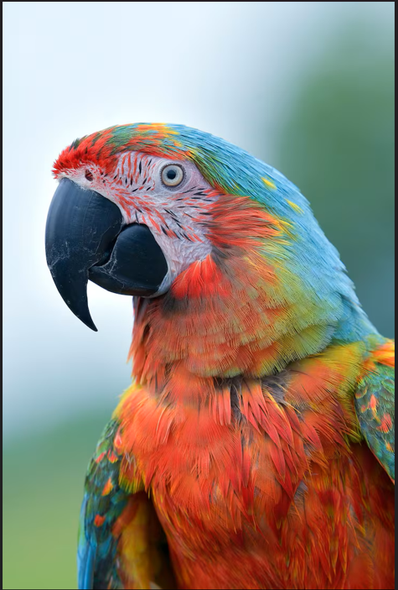
Problem 1: Quantizations
Asmi S.L. | CB.SC.U4CYS24108 | cb.sc.u4cys24108@cb.students.amrita.edu
Divija G.K. | CB.SC.U4CYS24117 | cb.sc.u4cys24117@cb.students.amrita.edu
G.Dheebak Raaj | CB.SC.U4CYS24118 | cb.sc.u4cys24118@cb.students.amrita.edu
Gayatri Rajesh | CB.SC.U4CYS24120 | cb.sc.u4cys24120@cb.students.amrita.edu
Rithika | CB.SC.U4CYS24144 | cb.sc.u4cys24144@cb.students.amrita.edu
  Problem Background - compares the results of median cut and octree methods to observe how quantization affects image appearance and compression.
Visualization:
TABULARIZATION :
Property | Value
Image Type | JPEG
Resolution | 5760 x 3840
Format | JPEG
Source | GITHUB
Dataset Description :
This dataset consists of a single high-resolution JPEG image of a colorful parrot. The image contains strong edges, smooth color gradients, and a wide range of brightness levels. These characteristics make it suitable for testing and comparing different quantization techniques. The parrot’s feathers provide rich color variation, while the background offers smooth areas where compression effects can be easily observed.

Slide 2
Approach Limitation & Code
No | Step Name | Description (Short) | Code Reference
1 | Desaturation | Converts an RGB image to grey scale by averaging the minimum and maximum channel values. This reduces the image to brightness values only. | GitHub: https://github.com/Dheebak-12/mulitimedia/tree/main/Q1/Desaturation
2 | Median Cut | divides pixels into boxes with equal pixel counts, producing smoother tonal regions. | GitHub: https://github.com/Dheebak-12/mulitimedia/tree/main/Q1/Median_cut
3 | Octree (L1, L2) | stores colors in an octree structure and merges similar colors. It preserves edges better than Median Cut. | GitHub: https://github.com/Dheebak-12/mulitimedia/tree/main/Q1/Octree

Slide 3
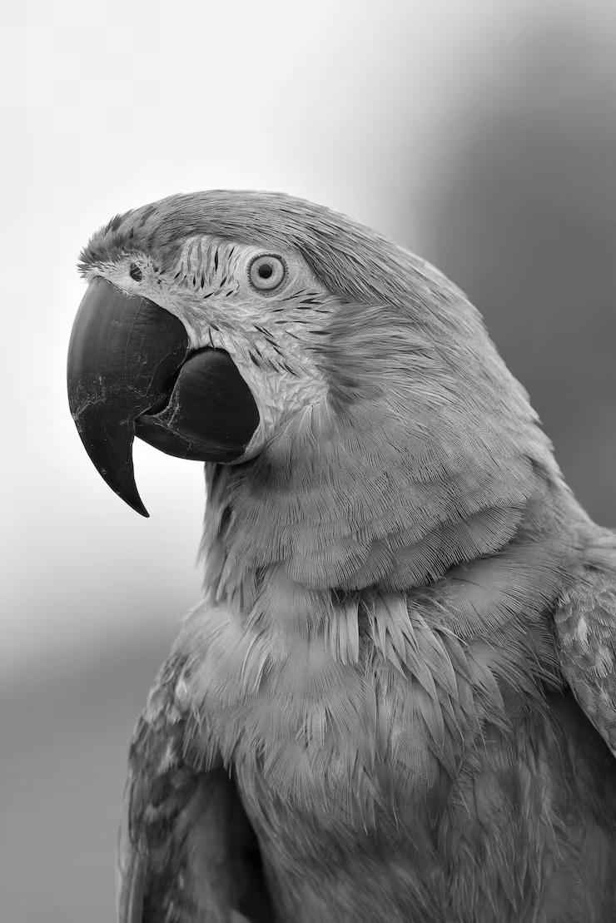
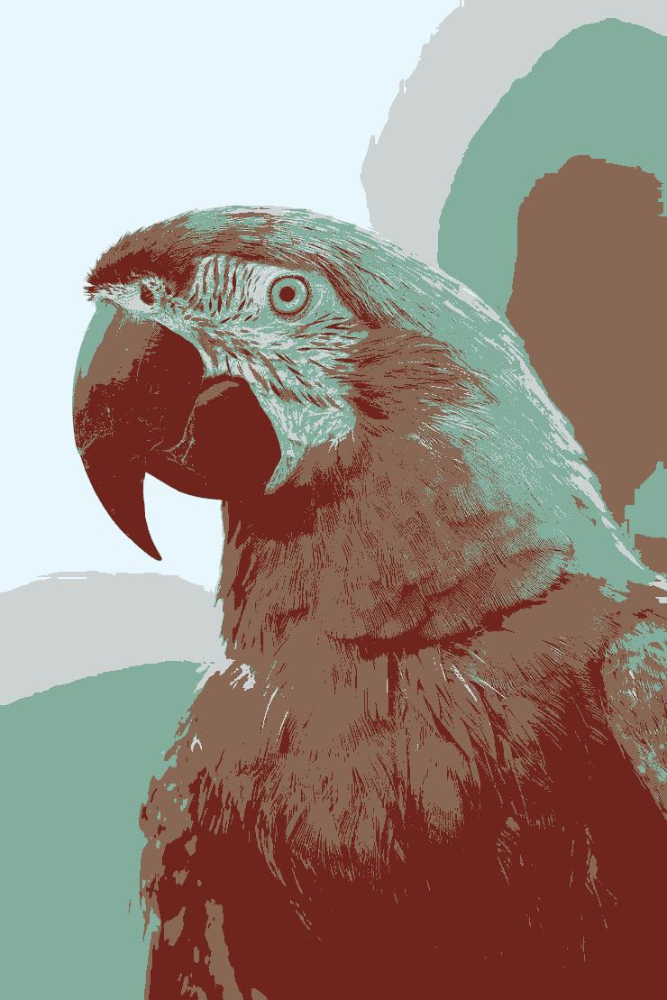
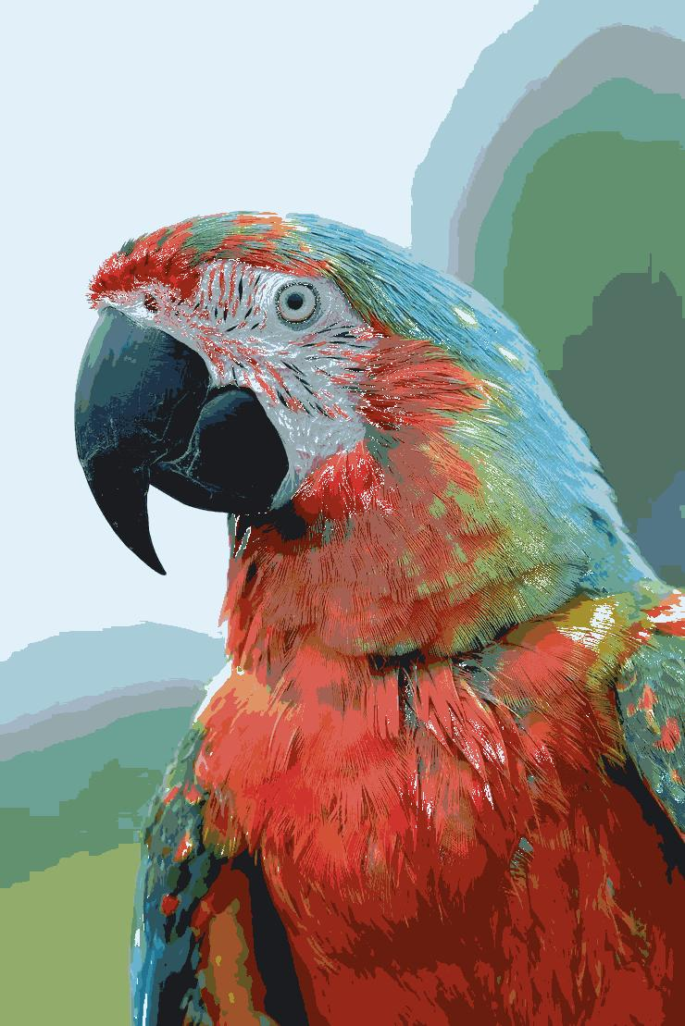
Empirical Results & Commentary
Octree Quantization
Greyscale via Desaturation
Median Cut
Max color=5
Max color=30
COMMENTARY
The desaturation method removes color by averaging the lightest and darkest RGB channels.
The result keeps the cat’s facial details but loses all color information, giving a smooth grey appearance.
Median Cut reduces the number of colors by splitting the pixel values into equal groups.
This produces a softer-looking image where smooth areas (like fur) blend well, but some fine details become slightly muted.
Octree quantization groups similar colors while preserving strong edges.
The output image looks very close to the original, with clear edges around the cat’s face and only slight reduction in color variety.
This method keeps structure and sharpness better than Median Cut.

Slide 4
Code Snippets
1. Greyscale via Desaturation
2.Median Cut Quantization
3. Octree Quantization
from PIL import Image
img = Image.open("input.jpg")
w, h = img.size
out = Image.new("L", (w, h))
for y in range(h):
for x in range(w):
r, g, b = img.getpixel((x, y))
out.putpixel((x, y), (max(r, g, b) + min(r, g, b)) // 2)
out.save("gray_lightness.jpg")
print("Done")
from PIL import Image
def apply_median_cut(src, dst, max_colors):
img = Image.open(src).convert("RGB")
reduced = img.quantize(colors=max_colors, method=0).convert("RGB")
reduced.save(dst)
print("Saved:", dst)
max_colors = int(input("Enter max colors: "))
apply_median_cut("input.jpg", "output_median_cut.jpg", max_colors)
from PIL import Image
def apply_octree(src, dst, max_colors):
img = Image.open(src).convert("RGB")
reduced = img.quantize(colors=max_colors, method=2).convert("RGB")
reduced.save(dst)
print("Saved:", dst)
max_colors = int(input("Enter max colors: "))
apply_octree("input.jpg", "output_octree.jpg", max_colors)
1. Greyscale via Desaturation:
https://tannerhelland.com/2011/10/01/grayscale-image-algorithm-vb6.html
2.Median Cut:
https://github.com/Chadys/QuantizeImageMethods
3. Octree:
https://www.cg.tuwien.ac.at/research/publications/1988/purgathofer-1988-simple/purgathofer-1988-simple-Paper.PDF
https://observablehq.com/@tmcw/octree-color-quantization
REFERENCES

Slide 5
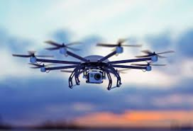
Problem 2: Rate - distortion quantization
Rate–Distortion quantization balances image quality and bit-rate.
K-Means groups pixels into K color clusters using color distance.
Distortion is measured as the squared difference between a pixel and its centroid.
Rate is computed from cluster usage probability (R = −log₂(p)).
RD-KMeans adds a rate penalty λR to control compression strength.
Small λ favors quality; large λ forces stronger compression.
Pixels join the cluster with the lowest RD cost each iteration.
Centroids update using the average color of assigned pixels.
The final image shows how λ affects palette size, quality, and bit-rate.
Tabularization :
Property | value
Resolution | 272 x 185
Image type | PNG
Color type | RGB
Task | Rate Distortion based color Quantization
Visualization:
Data Source:
input image :
(RGB color photo)
Data Description :
The diverse colors and textures allow clear observation of how rate and distortion shift with λ (trade off parameter)

Slide 6
Approach Limitation & Code
Approach : | Description : | Code Reference:
1. Load the image | The program loads the input image. | https://github.com/Dheebak-12/mulitimedia/tree/main/Q2/Rate_distortion_quantization
2. Choose how many colors (K) you want | You select K values (like 2, 4, 8, 16).
3. Start clustering the colors | It picks K random colors from the image as initial cluster centers.
4. Update the color groups | Each pixel is assigned to the nearest color cluster.
5.Replace original pixels with their group’s color | Each cluster’s average color becomes its new representative color.
6. Measure quality | All pixels are recolored using their cluster’s representative color.
7. Save the compressed image | MSE, PSNR, and Rate are calculated, and the quantized image is saved (e.g., image_K16.png)
8. Save the results | A CSV of quality metrics and a Rate–Distortion plot are generated.

Slide 7
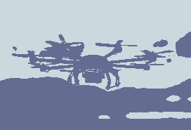
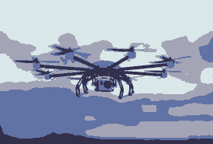
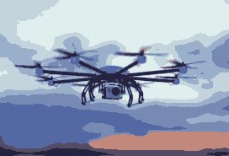
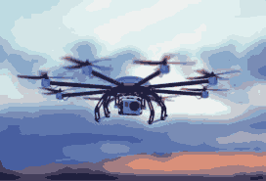
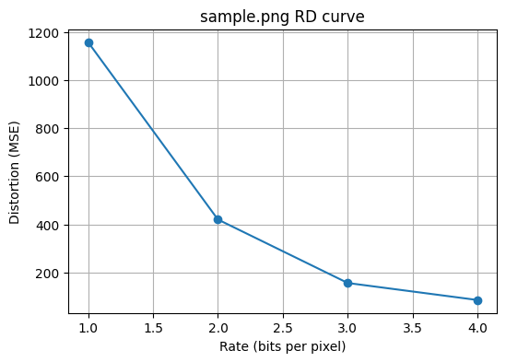
Empirical Results & Commentary
Input output (4 images)
CSV values :
K,rate_bpp,mse,psnr_db
2,1.000000,1157.278642,17.496424
4,2.000000,420.010957,21.898197
8,3.000000,156.133331,26.195847
16,4.000000,85.395330,28.816462
Commentary :
• Standard K-Means minimizes only squared distortion.
• RD-KMeans adds rate term to balance cluster usage.
• Low λ behaves similar to normal K-Means.
• High λ forces compression by merging rare colors.
• Higher λ increases visible quantization artifacts.
• RD-KMeans reduces bit-rate while controlling distortion.

Slide 8
Code Snippets
import numpy as np, matplotlib.pyplot as plt
from PIL import Image
from math import log2
def kmeans(X, K, iters=50):
N, D = X.shape
C = X[np.random.choice(N, K, replace=False)]
for _ in range(iters):
d = ((X[:, None] - C[None])**2).sum(2)
L = np.argmin(d, 1)
Cn = np.array([X[L==k].mean(0) if np.any(L==k) else C[k] for k in range(K)])
if np.allclose(C, Cn, atol=1e-3): break
C = Cn
return C, L
def quantize(path, K):
img = np.array(Image.open(path).convert("RGB")).astype(np.float32)
H, W, _ = img.shape
X = img.reshape(-1, 3)
C, L = kmeans(X, K)
return img, C[L].reshape(H, W, 3)
def mse(a, b): return ((a - b)**2).mean()
def psnr(m): return 10 * np.log10((255**2) / m)
def run(path, Ks):
for K in Ks:
orig, q = quantize(path, K)
D, P, R = mse(orig, q), psnr(mse(orig, q)), log2(K)
Image.fromarray(q.astype(np.uint8)).save(f"out_K{K}.png")
print(f"K={K} | MSE={D:.1f} | PSNR={P:.1f} dB | Rate={R:.2f}")
plt.plot(R, D, 'o')
plt.xlabel("Rate (bits/pixel)"); plt.ylabel("Distortion (MSE)")
plt.title("Rate–Distortion Curve"); plt.grid(); plt.show()
# Example: run("image.jpg", [2, 4, 8, 16, 32])
Reference
https://www.geeksforgeeks.org/machine-learning/image-compression-using-k-means-clustering/
https://youtu.be/EItlUEPCIzM?si=XwUwgmInl_-zwaFs

Slide 9
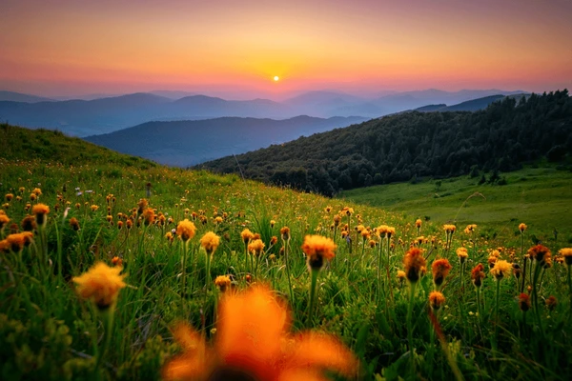
Problem 3: Sampling and Frequency
  PROBLEM DESCRIPTION :
  This problem demonstrates how an image behaves under different sampling techniques. Frequency sampling removes high-frequency components using FFT, while spatial sampling reduces resolution by selecting every f-th pixel. The goal is to observe blur, pixelation, and detail loss at different sampling rates.
TABULARIZATION :
Visualization:
Property | Value
Image Type | JPEG
Resolution | 600x400
Format | JPEG
Source | GOOGLE
Dataset Description :
A single natural landscape image downloaded from Google, containing mountains, sky, and flowers.This image is used to analyze the effects of frequency-domain and spatial-domain sampling.

Slide 10
Approach Limitation & Code
No | Step Name | Description (Short) | Code Reference
1 | Desaturation | Converts the input RGB image to gray scale so that frequency sampling (FFT) can be applied. | https://github.com/Dheebak-12/mulitimedia/tree/main/Q3
2 | Frequency Sampling (FFT) | Reduces image resolution in the frequency domain by keeping only low-frequency components (1/f sampling). This simulates undersampling.
3 | Spatial Sampling (1/f Resolution) | Downsamples the RGB image by taking every f-th row and column. This reduces spatial resolution directly.

Slide 11
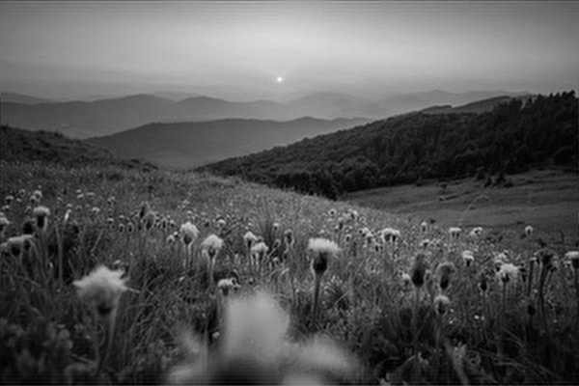
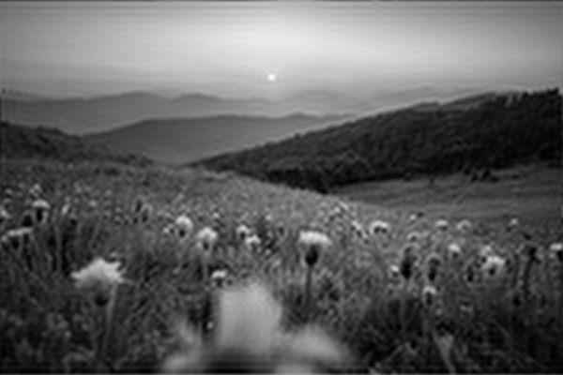



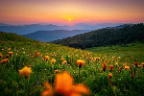

Empirical Results & Commentary
FREQ 1/2
FREQ 1/4
FREQ 1/8
FREQ 1/16
SPATIAL- 1/4
SPATIAL- 1/8
SPATIAL- 1/16
SPATIAL- 1/2
Story:
The script first opens the picture and prepares two forms: a gray img for FFT ops and an RGB image for spatial reduction.
For freq-based sampling, the gray image is moved to the freq domain, keeping mainly Low Frequency info.
After applying Inverse Fast Fourier Transform, the result turns soft and blurry because most High Frequency detail is removed.
In spatial downsampling, the RGB image is reduced by selecting every nth pixel without any filtering.
This direct reduction introduces pixel blocks + aliasing, which get worse at bigger factors (1/8, 1/16).
In short: FFT filtering smooths out detail, while spatial skipping produces blocky, low-resolution output.
Commentary
The image is first switched to a grayscale format so that frequency-based sampling can be applied effectively.
Using the FFT, the frequency content is analyzed and only the lower-frequency parts are kept while the rest are trimmed out.
After applying the Inverse FFT (IFFT), the image is rebuilt with missing high-frequency edges, giving it a softer appearance.
For spatial sampling, the algorithm simply drops pixels at fixed intervals in the RGB image without using any filtering step.
The outputs highlight the contrast between the smooth blur produced by FFT filtering and the blocky aliasing caused by spatial pixel skipping.

Slide 12
Code Snippets
from PIL import Image
import numpy as np
# Load image
gray = np.array(Image.open("img.jpg").convert("L"))
rgb = np.array(Image.open("img.jpg").convert("RGB"))
print("Gray :", gray.shape)
print("RGB :", rgb.shape)
# Frequency sampling (FFT)
def freq_sample(img, f):
F = np.fft.fftshift(np.fft.fft2(img))
H, W = img.shape
h, w = H//f, W//f
hs, ws = H//2 - h//2, W//2 - w//2
F_low = np.zeros_like(F)
F_low[hs:hs+h, ws:ws+w] = F[hs:hs+h, ws:ws+w]
out = np.fft.ifft2(np.fft.ifftshift(F_low))
out = np.abs(out)
out = ((out - out.min()) / (out.ptp() + 1e-9) * 255).astype(np.uint8)
return out
# Spatial sampling (RGB)
def spatial_sample(img, f):
return img[::f, ::f].copy()
factors = [2, 4, 8, 16]
for f in factors:
out_f = freq_sample(gray, f)
Image.fromarray(out_f).save(f"freq_1_{f}.png")
print(f"Freq 1/{f} →", out_f.shape)
out_s = spatial_sample(rgb, f)
Image.fromarray(out_s).save(f"spatial_1_{f}.png")
print(f"Spatial 1/{f} →", out_s.shape)
print("Done.")
REFERENCES :
Gonzalez, R. C., & Woods, R. E. (2018). Digital Image Processing (4th ed.). Pearson.
Oppenheim, A. V., Schafer, R. W., & Buck, J. R. (1999). Discrete-Time Signal Processing (2nd ed.). Prentice Hall.
Bradski, G. (2000). The OpenCV Library. Retrieved from https://docs.opencv.org/

